Slide 1

WAY TO ENTERPRISE
AWS
VTI ACADEMY
Author: duy.nguyenngoc1@vti.com.vn

Slide 2
Aurora Service
Is a database engine type of RDS, support MySQL (version 5.7), PostgreSQL (version 12)
Is a proprietary technology from AWS (not open sourced)
Claims 5x performance improvement over MySQL, over 3x the performance of Postgres on RDS
Usecases: Recommend to use instead of MySQL & PostgreSQL
Regional service
Price: https://aws.amazon.com/rds/pricing
Tutorial: https://docs.aws.amazon.com/AmazonRDS/latest/UserGuide/Welcome.html

Slide 3
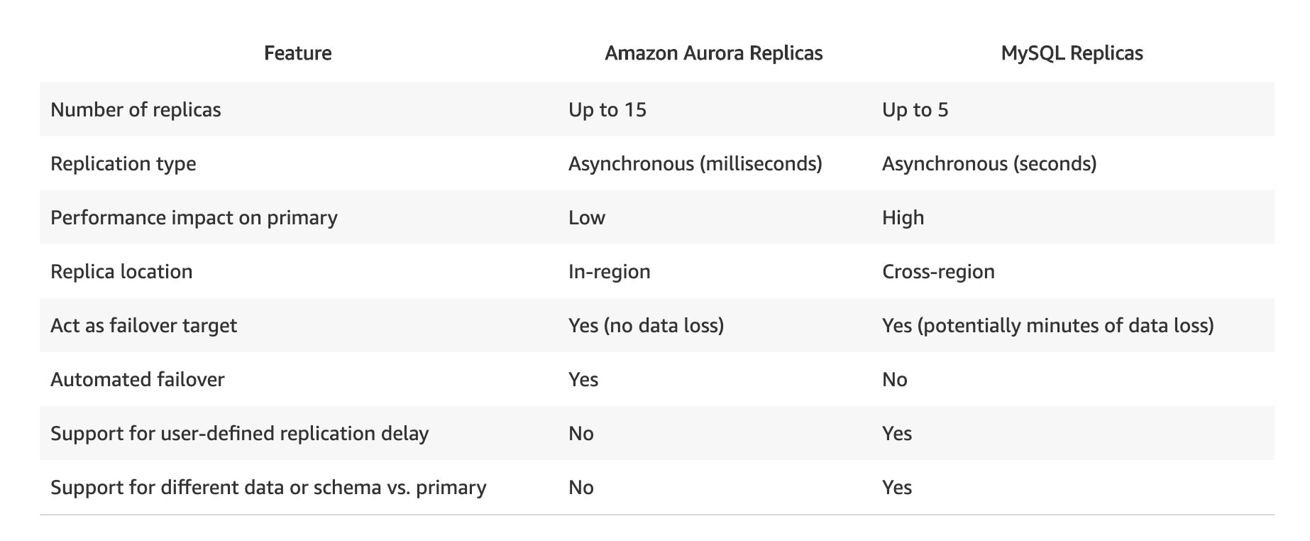
Aurora Service
Comparing
Aurora costs more than RDS (20% more) - but is more efficient

Slide 4
Aurora Service
Demo
  Create Database
  Add more reader instance

Slide 5
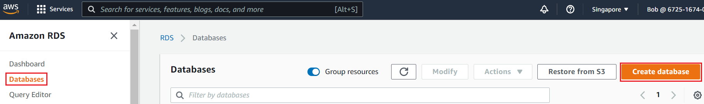
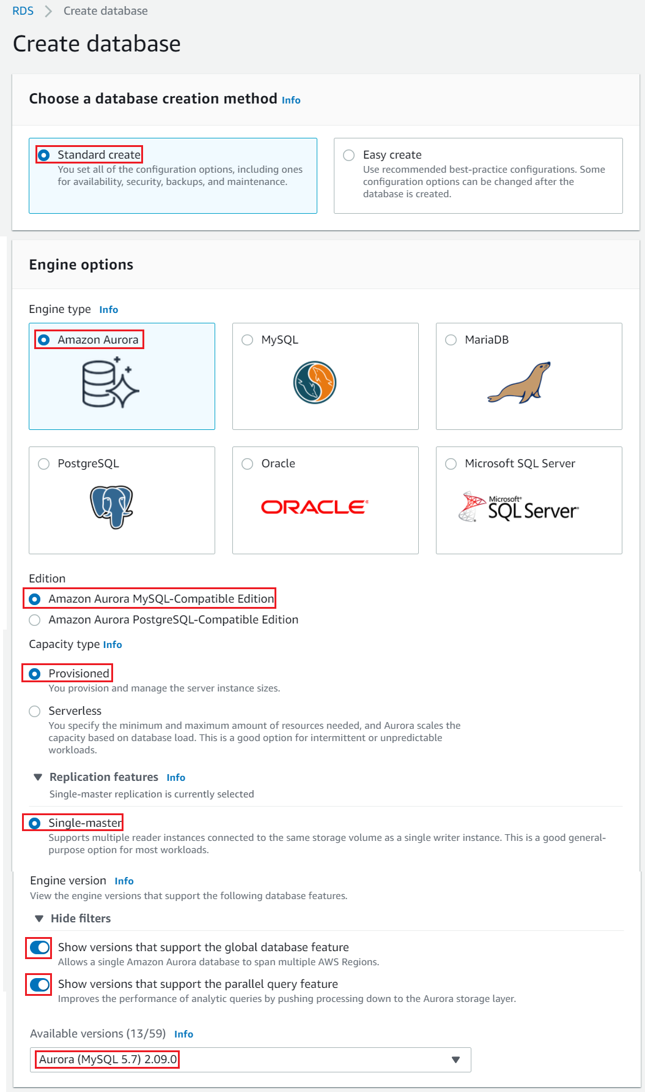
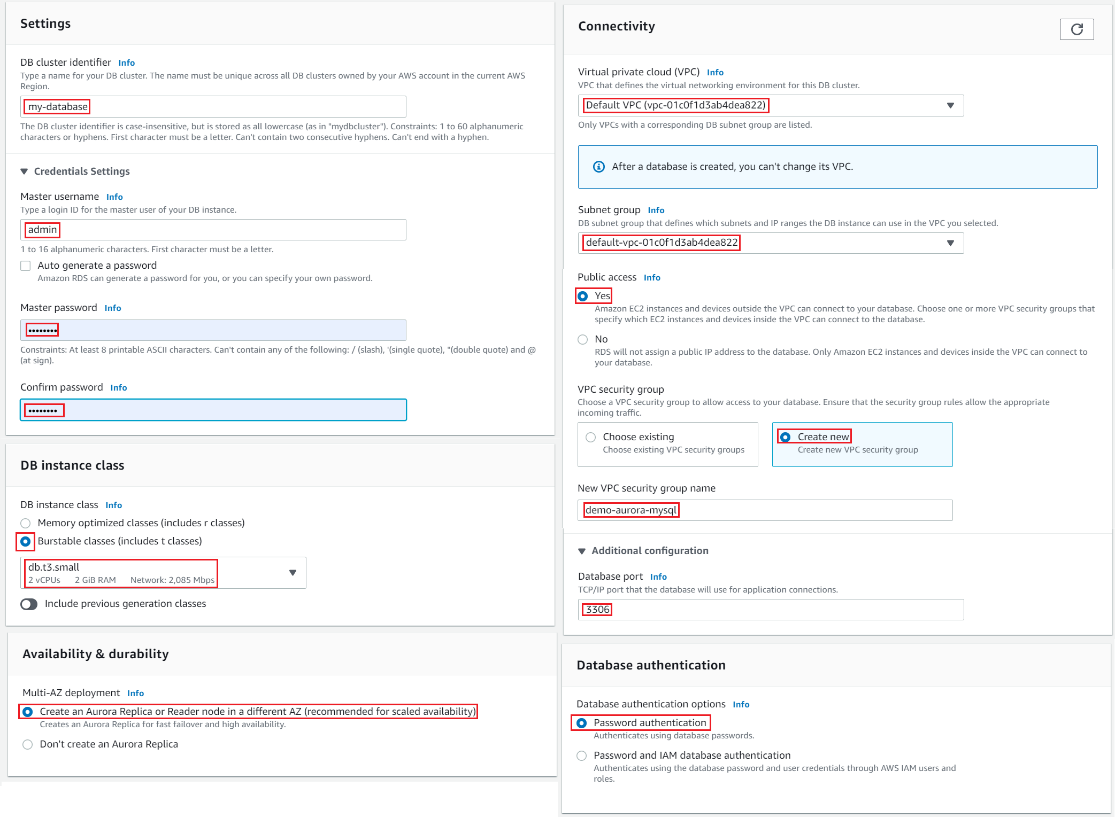
Aurora Service
  Create Database

Slide 6
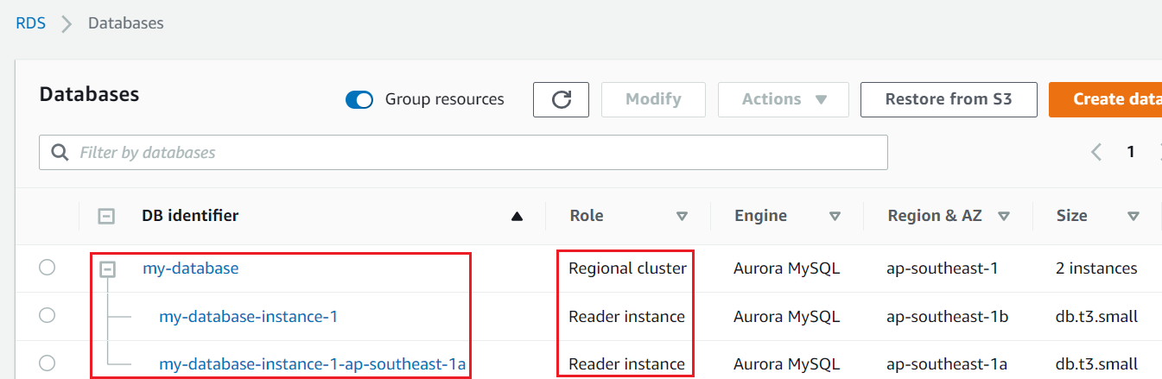
Aurora Service

Slide 7
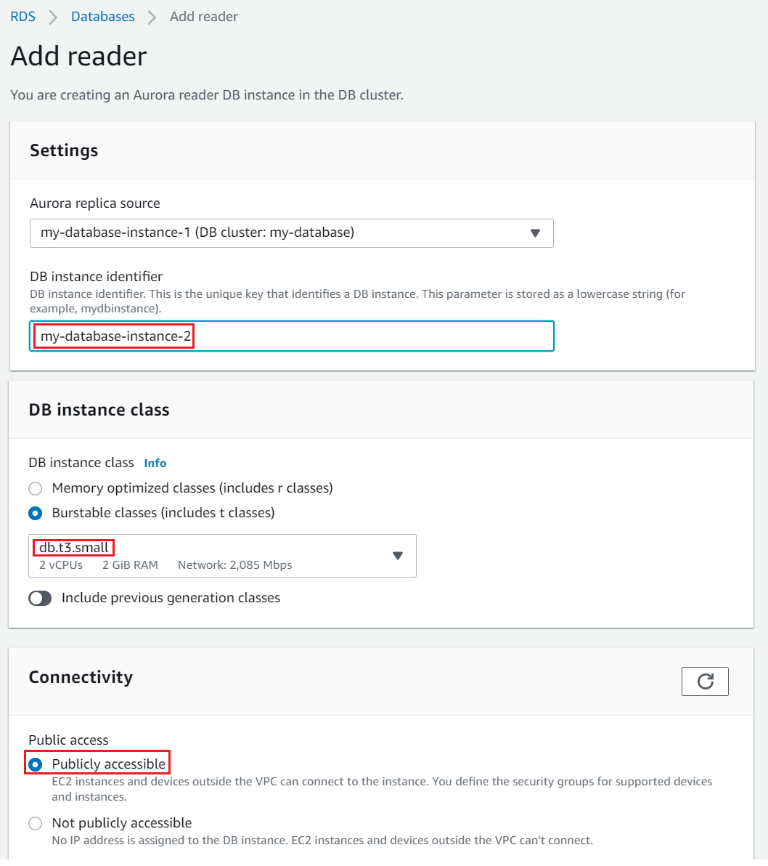
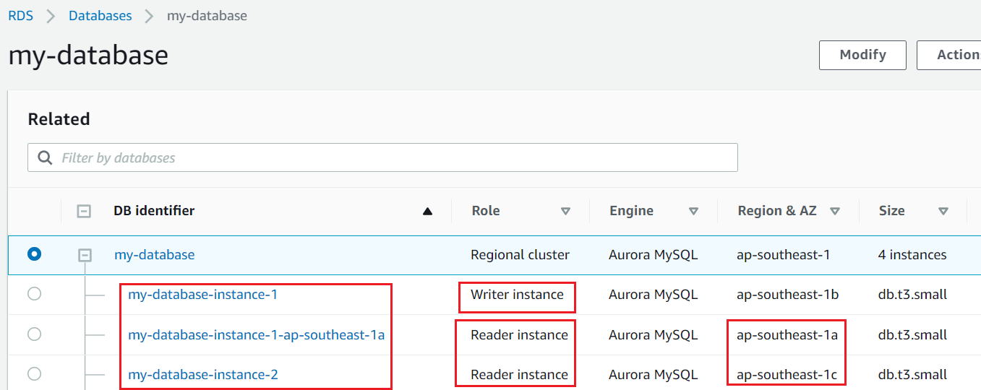
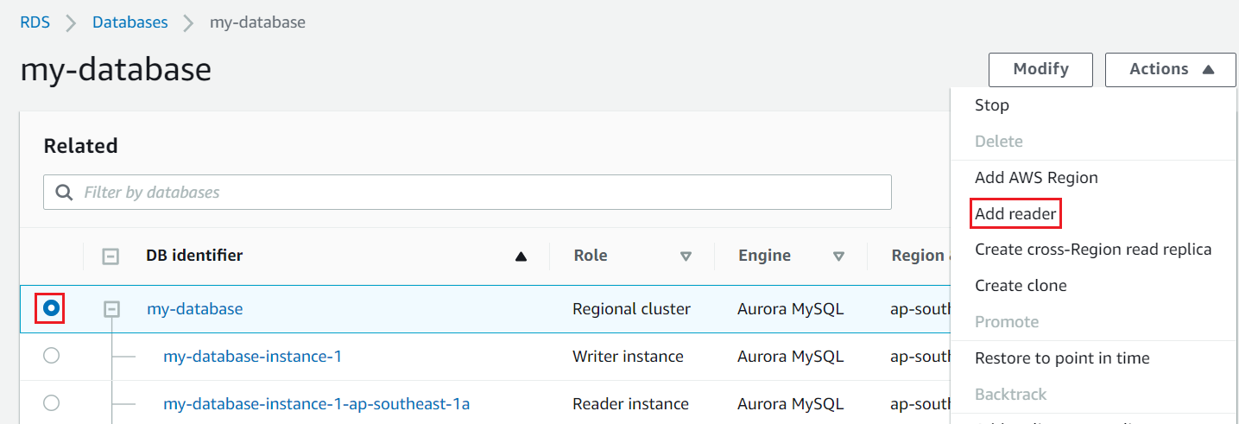
Aurora Service
  Add more reader instance

Slide 8
Assignment
  Self-practice

Slide 9
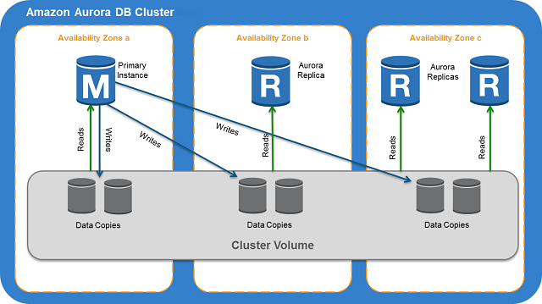
Aurora Service
Components
  DB Cluster
  DB Instance
  Cluster Volume
  Global Clusters

Slide 10
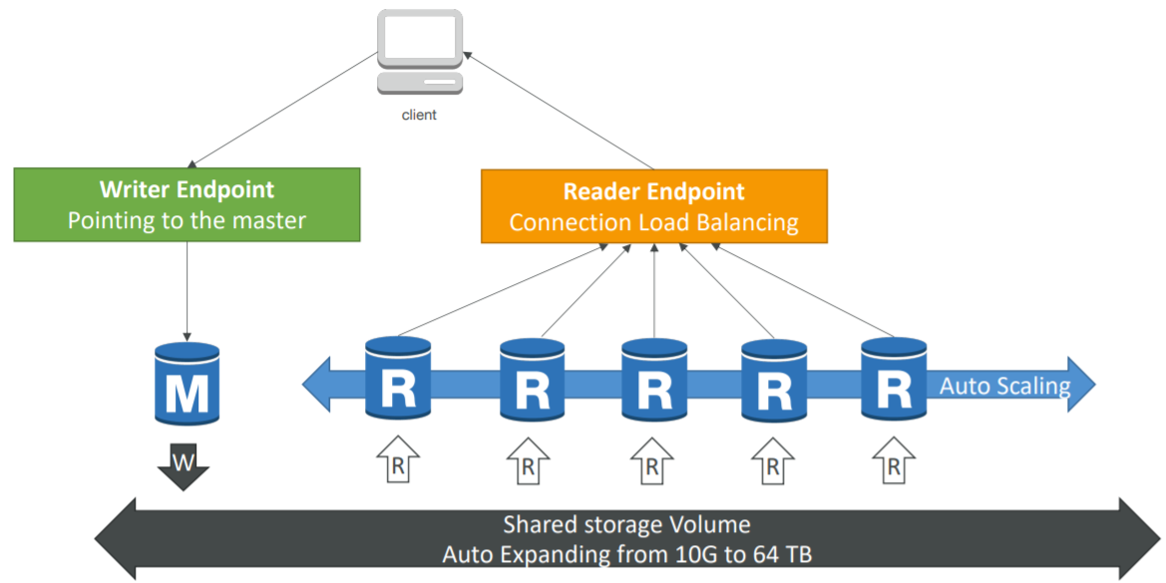
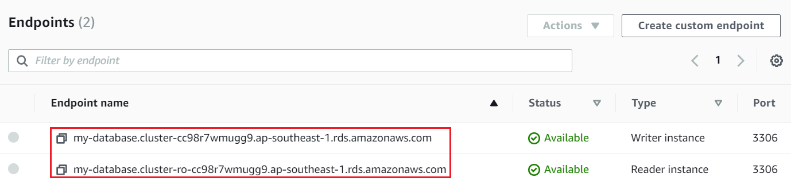
Aurora Service
  DB Cluster
    Working in a region
    Including: 1 writer DB Instances & multiple reader DB Instances
    Providing 1 endpoint for writing request & 1 endpoint for reading request
Endpoint

Slide 11
Aurora Service
  DB Instance
    Working in a zone
    Support 2 database engine: MySQL (Version 5.7) & PostgreSQL (Version 12)
    Setup: Hardware, Networking, Security, Master account, Database authentication, Database , Backup, monitoring, log, Maintenance, Delete protection, ... Similar to RDS
    2 types: Primary DB Instance, Aurora Replica
      Primary DB Instance
        Read/Write request
        Modify data in cluster volume

Slide 12
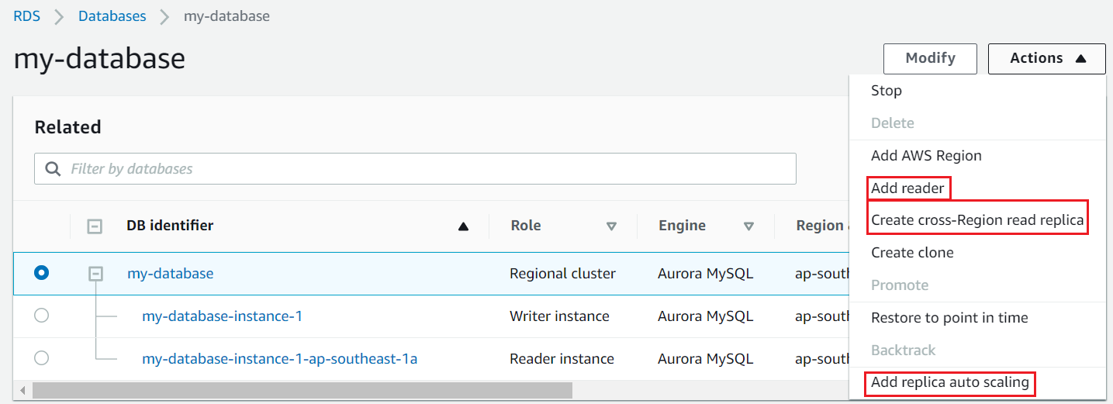
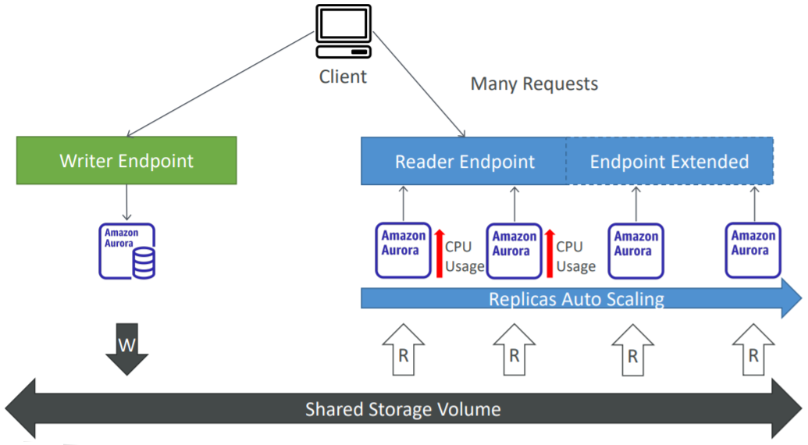
Aurora Service
      Aurora Replica
        Read request
        Support Cross A-Z, Cross region, Auto Scaling, Automatic failover
          Automatic failover: Automatically assign replica to primary DB Instance when primary DB Instance is unavailable in less than 30 seconds
        Max 15 Replica, Usually setup each zone will have 1 DB Instance to increase HA
Replica autoscaling

Slide 13
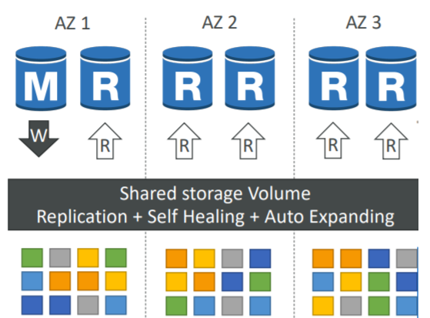
Aurora Service
  Cluster Volume
    Is a virtual database storage volume to manage data for DB instances
    Storage is striped across 100s of volumes
    Data is synchronized by Amazon In many zones
    Each zone will have 2 copies of cluster data (near real-time)
    Self-healing with peer-to-peer replication (Automatically scan errors and repair disks)
  Backup
    Backtrack: restore data at any point of time without using backups
    Do not affect performance

Slide 14
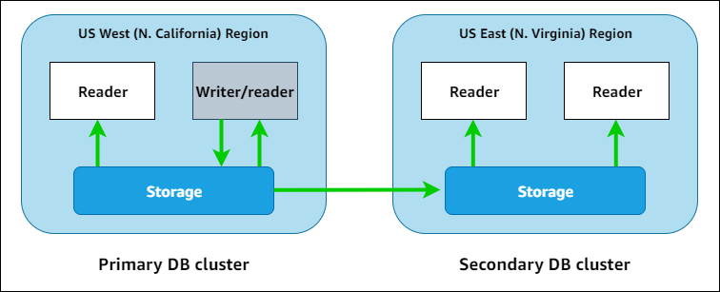
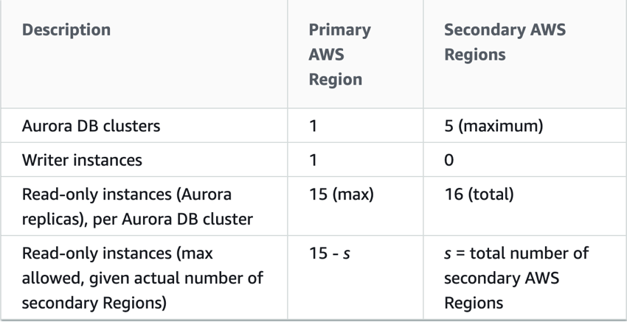
Aurora Service
  Global Clusters
    Support Aurora Database runs across multiple Regions
    Low latency
    Cross-Region, automatic failover
    Support Enabling Write Forwarding
    Allows secondary DB Cluster to also be able to write storage volumes
    Usecase: disaster recovery
Tutorial: Link1, Link2

Slide 15
Aurora Service
Feature
  Capacity type
  Query in console

Slide 16
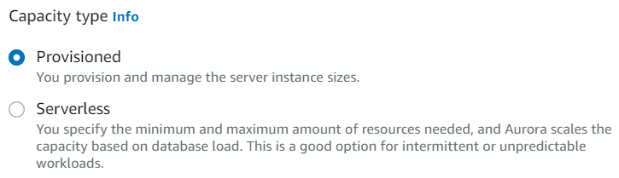
Aurora Service
  Capacity type
    2 types: Provisioned, Serverless
    Provisioned
      You provision and manage the scale of instances in the cluster (Similar to RDS) (Instance type, Storage, Multi A-Z, ...)

Slide 17
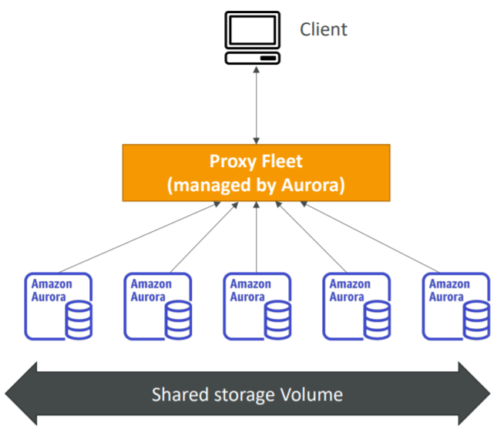
Aurora Service
    Serverless
      Auto scaling instance (scale up/down) based on workload in cluster
      No capacity planning needed: Don’t need config Instance Class, Storage, Multi A-Z, ...)
      No time cooldown when scaling
      Usecases:
        Application with infrequent, unpredictable workloads
        New Application, not sure how to need the database
        Application is only used for a few hours in a day (Ex: database for dev, test is only used in working hours)
        Application has many tenants
Tutorial: https://www.youtube.com/watch?v=ciRbXZqBl7M

Slide 18
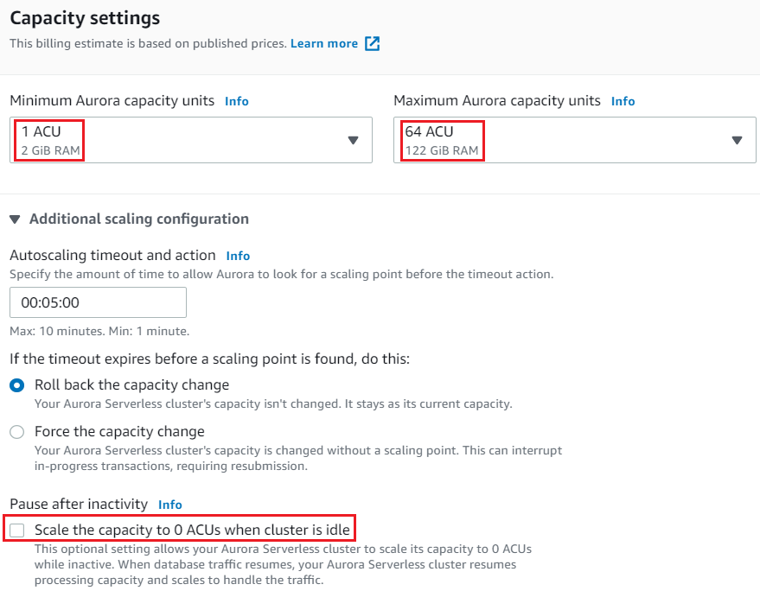
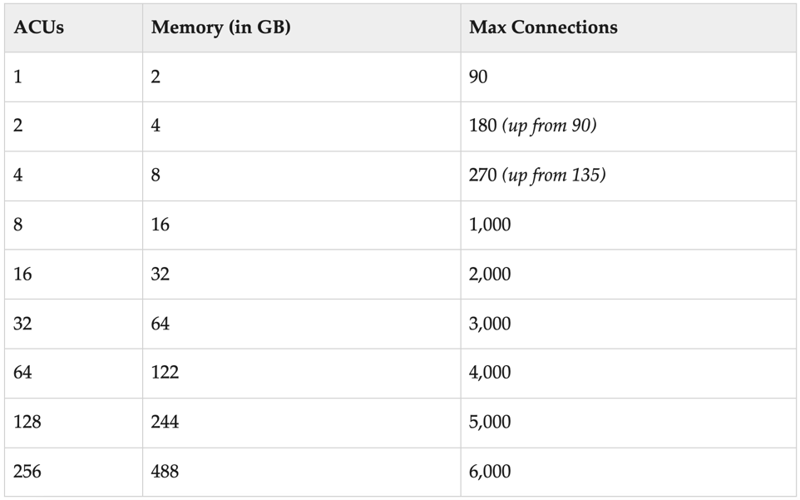
Aurora Service
      Automatically scale up/down hardware (CPU, RAM, Networking) based on ACU (Aurora capacity unit) usage
        Scale up: CPU more than 70%, Connection more than 90%
        Scale down: CPU less than 30%, Connection less than 40%
        Scale 10GB each time
        Can set up auto shutdown DB when ACU = 0 (no incoming request)
      Aurora capacity unit (ACU)
        Is a unit for measuring workload
        Is a combination of parameters: RAM, CPU, Networking
Each ACU provides 2 GB of RAM

Slide 19
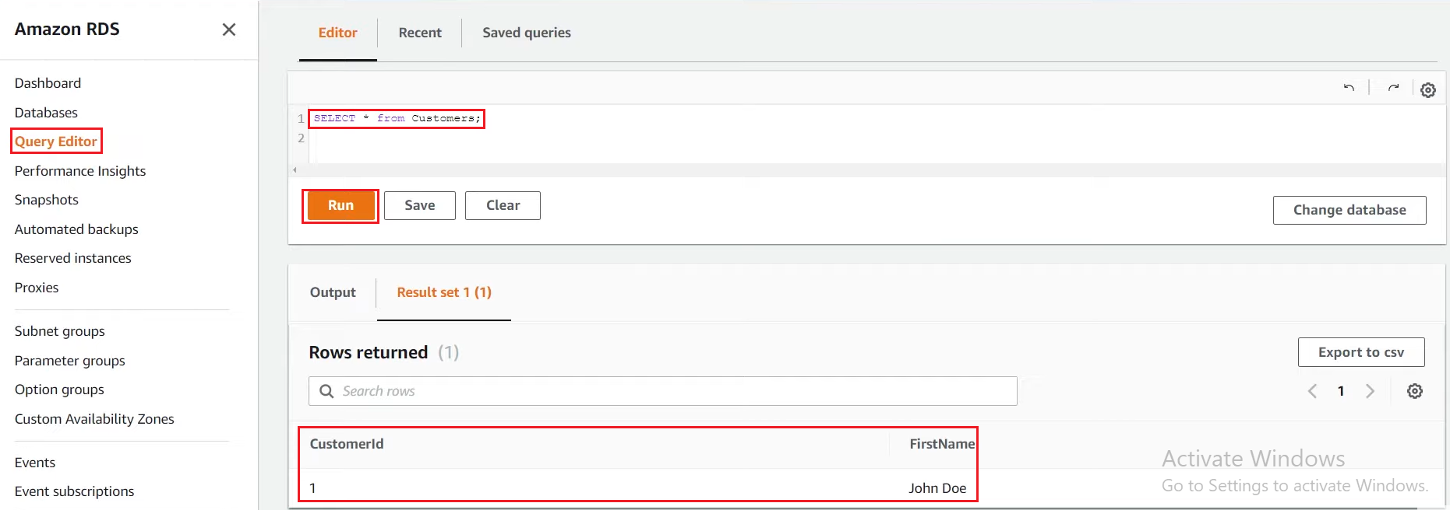
Aurora Service
  Query in console
    Only support Aurora Serverless databases
Tutorial: https://youtu.be/ciRbXZqBl7M?t=765

Slide 20
Assignment
  Self-practice

Slide 21
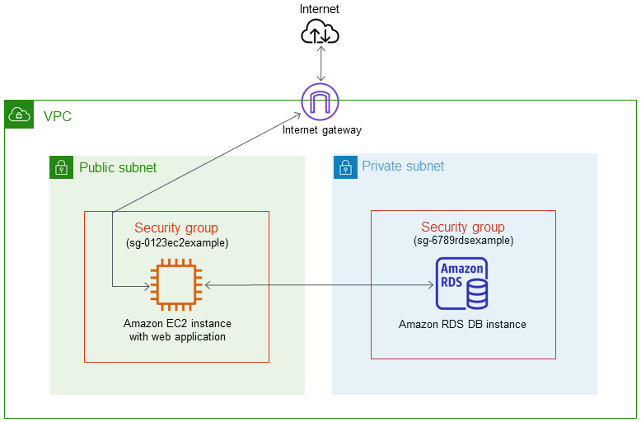
Aurora Service
Web server + Database
Tutorial: https://docs.aws.amazon.com/AmazonRDS/latest/AuroraUserGuide/TUT_WebAppWithRDS.html

Slide 22
Summary
Aurora is a database engine type of RDS, support MySQL (version 5.7), PostgreSQL (version 12)
Is a proprietary technology from AWS (not open sourced)
Faster and more expensive than MySQL & PostgreSQL on RDS
Relational service
Components
  DB Cluster: Providing 1 endpoint for writing request & 1 endpoint for reading request
  DB Instance: Primary DB/Aurora Replica Instance, Cross A-Z, Cross region, Auto Scaling, Automatic failover
  Cluster Volume: 2 copies of cluster data per zone (near real-time), Self-healing

Slide 23
Summary
  Global Database Clusters: Support Aurora Database runs across multiple Regions, Enabling write forwarding
Features
  Capacity type: Provisioned, Serverless
  Query in console: Only support Aurora Serverless Database

Slide 24
Q & A
Copyright © VTI Academy All Rights Reserved

